Slide 1
Problem solving using Java – CSE1006
[L-T-P-C: 1-0-4-3]
MODULE – 4
Inheritance and Polymorphism
[Lecture:3 & Practical:14]
Mr. R C Ravindranath, Asst. Prof, SOE-CSE
Notes:
Mr. R C Ravindranath, Asst. Prof., SOE-CSE

Slide 2
Inheritance in java is a mechanism in which one object acquires all the properties and behaviors of parent object.
Inheritance represents the IS-A relationship, also known as parent-child relationship.
Inheritance can be defined as the process where one class acquires the properties (methods and fields) of another. With the use of inheritance the information is made manageable in a hierarchical order.
The class which inherits the properties of other is known as subclass (also known as derived class or child class) and the class whose properties are inherited is known as superclass (base class or parent class).
The idea behind inheritance in java is that you can create new classes that are built upon existing classes.
When you inherit from an existing class, you can reuse methods and fields of parent class, and you can add new methods and fields also.

Slide 3
Advantages of Inheritance
For Method Overriding (so runtime polymorphism can be achieved).
For Code Reusability (a programmer reuses the super class code without rewriting it, in creation of sub classes)
Syntax of Java Inheritance
class Subclass-name extends Superclass-name
{
//methods and fields
}
The extends keyword indicates that you are making a new class that derives from an existing class.
The meaning of "extends" is to increase the functionality.
In the terminology of Java, a class which is inherited is called parent or super class and the new class is called child or subclass.

Slide 4
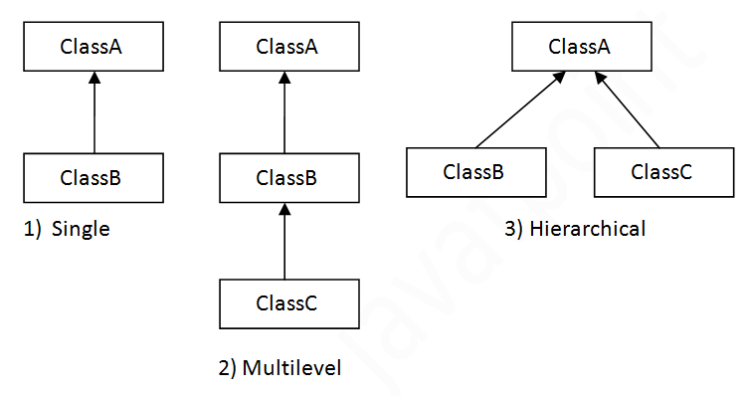
Types of inheritance in java
On the basis of class, there can be three types of inheritance in java: single, multilevel and hierarchical.
In java programming, multiple and hybrid inheritance is supported through interface only.

Slide 5
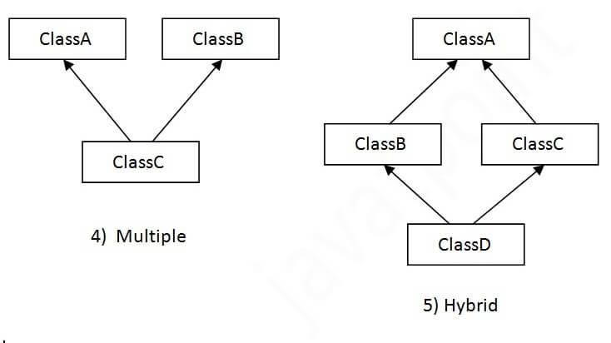

Slide 6
Activity 1: Single Inheritance Example
class Animal{
void eat()
{System.out.println("eating...");}
}
class Dog extends Animal{
void bark()
{System.out.println("barking...");}
}
class SingleInheritance{
public static void main(String args[]){
Animal a=new Animal();
a.eat(); // valid
Dog d=new Dog();
d.bark(); // valid
d.eat(); // valid
}
}
Output:
eating...
barking...
eating...

Slide 7
Activity 2: Multilevel Inheritance Example
class Animal{
void eat()
{System.out.println("eating...");}
}
class Dog extends Animal{
void bark()
{System.out.println("barking...");}
}
class BabyDog extends Dog{
void weep()
{System.out.println("weeping...");}
}
class MultiLevel{
public static void main(String args[]){
BabyDog d=new BabyDog();
d.weep();
d.bark();
d.eat();
}
}
Output:
weeping...
barking...
eating..

Slide 8
Activity 3: Hierarchical Inheritance Example
class Animal{
void eat() {
System.out.println("eating...");}
}
class Dog extends Animal{
void bark(){
System.out.println("barking...");}
}
class Cat extends Animal{
void meow() {
System.out.println("meowing...");}
}
class Hierarchical{
public static void main(String args[]){
Cat c=new Cat();
c.eat(); // valid
c.meow(); // valid
//c.bark(); //Compile time error
}}
Output:
eating...
meowing...

Slide 9
Member Access and Inheritance
Although a subclass includes all of the members of its super class, it cannot access those members of the super class that have been declared as private.
Behavior of Access Modifiers in Java Inheritance
• The private members of the superclass cannot be inherited to the subclass
• The protected members of a parent class can be inherited to a derived class
(but the usage of protected members is limited within the package)
• Public members can be inherited from all subclasses.
• The default members of the parent class can be inherited from the derived class within the same package.
Note: Every class in Java automatically extends the root class Object (if it does not explicitly extends another class)

Slide 10
Multiple inheritance is not supported in java?
Multiple inheritance is not supported in Java through classes. But this can be achieved through interfaces.
Consider a scenario where A, B and C are three classes. The C class inherits A and B classes. If A and B classes have same method and you call it from child class object, there will be ambiguity to call method of A or B class.
class A{
void msg(){System.out.println("Hello");}
}
class B{
void msg(){System.out.println("Welcome");}
}
class C extends A,B{//suppose if it were
Public Static void main(String args[]){
C obj=new C();
obj.msg();//Now which msg() method would be invoked?
}
}

Slide 11
Method Overriding
If subclass (child class) has the same method as declared in the parent class, it is known as method overriding in java. It is used in runtime polymorphism.
In other words, if subclass provides the specific implementation of the method that has been provided by one of its parent class, it is known as method overriding.
Whatever the Parent has by default available to the Child through inheritance, if
the Child is not satisfied with Parent class method implementation then Child is
allowed to redefine that Parent class method in Child class (in its own way). This
process is called overriding.
The Parent class method which is overridden is called overridden method.
The Child class method which is overriding is called overriding method.
Rules for Java Method Overriding
1. Must be IS-A relationship (inheritance).
2. Methods must have same name and parameters as in the parent class. That is method signature must be same

